Slide 1
HACKSPRINT V2.0
HS101_PS03_TECH_TYCOONS
Aayush Joshi
Yashowardhan Shinde
Piyush Nagpal
Pratik Bathe

Slide 2

Problem Statement
Create a Cloud based Analytical Tool for Exam Assessment. Evaluation and Digitized Report Card Generation System with an option to publish it on Professional Platform like LinkedIn and others.
Problem Statement Number
PS03
Team Name
Tech Tycoons
Team Leader Name
Aayush Joshi
College Name
International Institute of Information Technology, Pune
Tech Tycoons

Slide 3
Our Approach
For Evaluation and Digitized Report Card Generation System we have planned to take an excel file from the user on our website as an input and then to use python and generate the report cards.
01
We are planning to make a website in which the user will upload the excel file and then process the files and display each student name and roll number in a drop down menu for displaying the report cards.
02
We are planning to use HTML, Java Script, PHP and CSS for the website and also python for evaluating and generating the Report Cards
03

Slide 4




Technology Stack
Languages Used:
JavaScript
PHP
HTML & CSS
Python
Packages Used:
Numpy
Pandas
Matplotlib
Openpyxl
Pymupdf
Pypiwin32

Slide 5
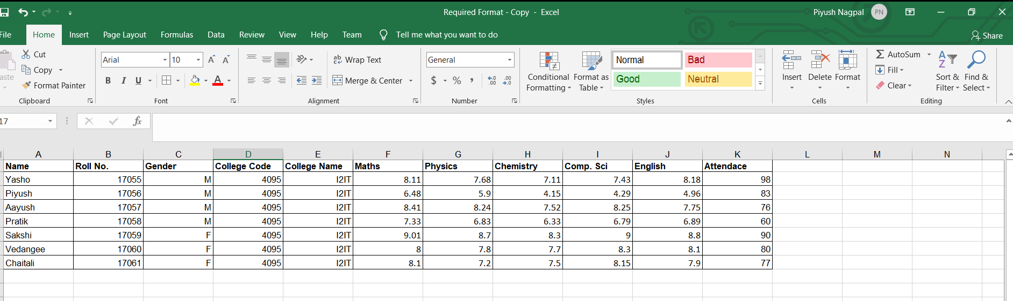
Sample Input Format

Slide 6
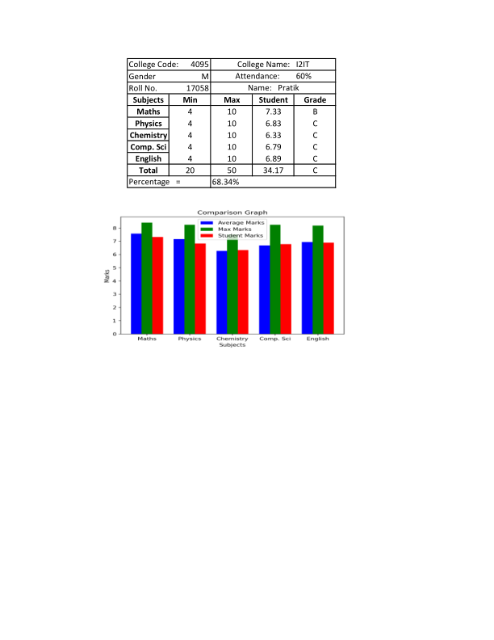
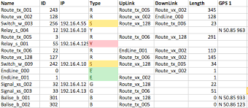
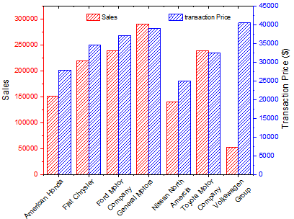
Back End Implementation Using Python
03
Generating PDF and PNG File as output
Processing the Input Data from the Website.
01
02
Analyzing the Input Data and creating visual representation of the Data

Slide 7
Sample File Generated
by the
Python Script

Slide 8


Front End Implementation Using HTML, PHP and
JavaScript
Taking Input as Excel from the User.
Fetching the output from the back end and displaying it.
1
3
2
4
Forwarding the Data to Backend Python Script
Redirecting the user to LinkedIn to upload his report card

Slide 9

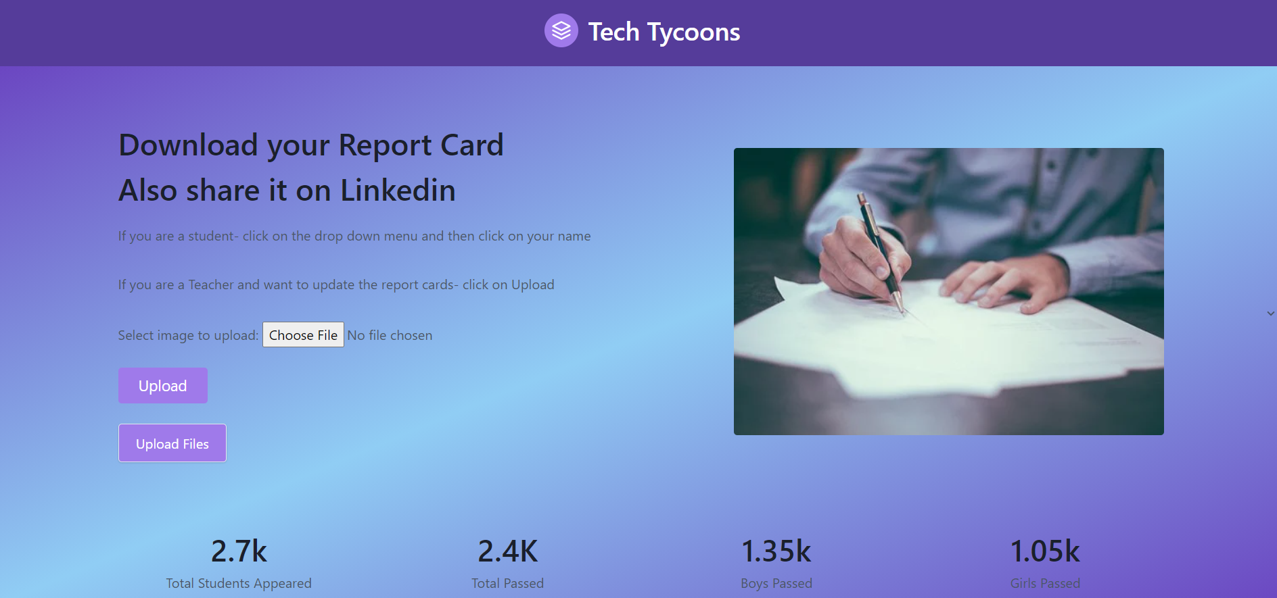
Sample
Website

Slide 10

Timeline
On Day 1:
Front End Development:
The basic format of the webpage was decided and implemented.
Basic functionality like uploading files was assigned.
Back End Development:
The input file format was decided and basic analysis was completed.
Graphical visualization of data was done.

Slide 11
Timeline
On Day 2:
Front End Development:
The website was fully developed and functionalities were added.
The website was integrated with the backend of the program.
Back End Development:
Functions like converting excel to pdf and pdf to png were added.
The styling of the report card was done.
The back end was connected with the front end.

Slide 12
Timeline
On Day 3:
Power point presentation was made
Final touches were given in terms of
styling, to the Front End and Back End
program.
Flow for video presentation was decided and implemented.

Slide 13
Thank You!

